Slide 1
Data Mining of Travel Reduction Program Survey
INFO 523
Group 7: Xiao Li, Wenkang Lv
Notes:
Good Evening everybody.
Today I would like to show you the data mining of our Pima County Travel Reduction Program Survey as our final project for this class.

Slide 2
Data Source
2024 Pima Association of Governments (PAG)'s Travel Reduction Program (TRP) data, collected through the annual Employee Travel Survey
  Reducing traffic congestion in the greater Tucson region continues to be a performance goal of Pima Association of Governments to support safe travel and enhance air quality.
  Employers with 100 or more full-time equivalent employees are required by local ordinances to participate in the Travel Reduction Program. Other employers may volunteer to participate.
  Companies required to participate in the program need to assign a transportation coordinator who will complete a travel reduction Activity Inventory Report, distribute an Annual Employee Survey and distribute travel reduction information and materials to employees.
Notes:
The data source is coming from where I work, which is an internal dataset.
We have a regional travel reduction program to encourage employees in Pima County to improve traffic congestion and air quality.
The program requires the big employers in Pima County to distribute an employee survey to investigate their employees’ commute travel behaviors, such as number of days taking transit, number of days telecommute.

Slide 3
Data Source
2024 Survey Data Effective Samples:
  138 Employers
  40,836 Employees
  296 Samples per Employer
Data Attribute:
  Company Information: Name, NAICS Code, Location, Work Activity.
  Commute Mode: Time of Days Commute to Work by Mode. (Drive Alone, Carpool, Ride hail, Bus, Cat Tran, Bike, Walk, Streetcar, or Work from Home)
  Alternative Commute Vehicle Types: Motorcycle, Electric Car, Hybrid Car, Plugin Hybrid Car
  Commute Schedule: Leave/Arrive Home, Leave/Arrive Work.
  Household Information: Number of Vehicles, Drivers, Fulltime/Parttime Workers.
  Commute Locations: Home Cross Street, Pickup Locations.

Slide 4
Data Preprocessing/Integration
HERE Routing API Estimated Commute Travel Time and Travel Distance.
  Survey Samples Missing Home Locations or Commute Schedules were Dropped.
Joined with American Community Survey from Census Bureau for Census Block Group Level Median Income.
  Home Locations without Census Block Group Median Income Data will be Imputed with Census Tract Level Median Income.
  If Census Tract Level Median Income is also Missing, it will be Filled with County Level Median Income.
Other Preprocessing for Analysis
  Impute Missing Values for Classification.
  Aggregation and Normalization for Clustering.
  Transaction Transformations and Discretization for Association.

Slide 5
Data Exploration: Mode Choice
Time of Days Commute by | Mean | Median | St. Dev | Minimum | Maximum
Drive Alone | 3.95 | 5 | 1.77 | 0 | 7
Carpool | 0.27 | 0 | 1.02 | 0 | 7
Ride Hail | 0.06 | 0 | 0.5 | 0 | 7
Bike | 0.07 | 0 | 0.51 | 0 | 7
Walk | 0.07 | 0 | 0.54 | 0 | 7
Bus | 0.09 | 0 | 0.6 | 0 | 7
Cat Tran | 0 | 0 | 0.09 | 0 | 5
Streetcar | 0.02 | 0 | 0.31 | 0 | 7
At Home | 0.32 | 0 | 0.91 | 0 | 7

Slide 6
Data Exploration: Household Travel
Variables | Data Source | Data Type | Mean | Median | St. Dev
Household Vehicles | TRP | Discrete Integer | 2.12 | 2 | 1.31
Household Drivers | TRP | Discrete Integer | 1.92 | 2 | 1.05
Household Fulltime Workers | TRP | Discrete Integer | 1.58 | 2 | 0.89
Household Parttime Workers | TRP | Discrete Integer | 0.31 | 2 | 0.62
Pickups and Drop-offs Under 18 | TRP | Discrete Integer | 0.31 | 0 | 0.58
Pickups and Drop-offs 18+ | TRP | Discrete Integer | 0.24 | 0 | 0.32
Home to Work Travel Time | HERE | Continuous Floating | 17.37 | 15.28 | 12.39
Home to Work Travel Distance | HERE | Continuous Floating | 12.42 | 9.97 | 11.58
Company NAICS Code | TRP | Nominal Categorical | - | - | -
ACS Median Income | ACS | Continuous Floating | 78305.76 | 74417 | 30479.86

Slide 7
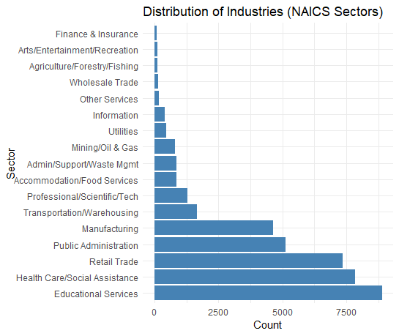
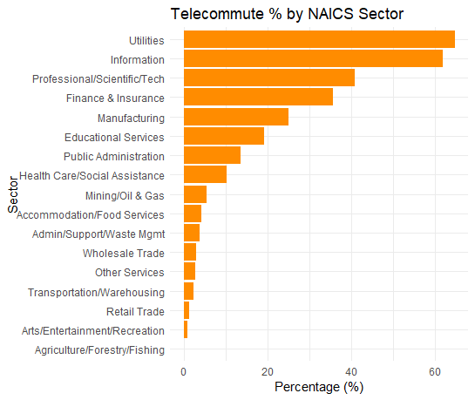
NAICS Code Exploration
Telecommute % for All Sectors: 14.03%

Slide 8
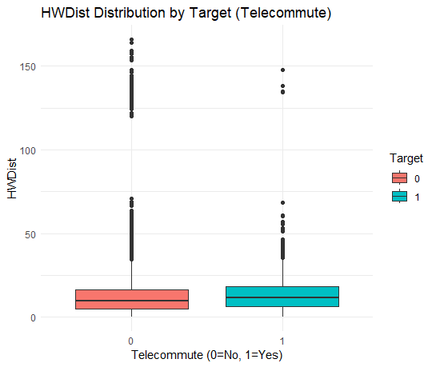
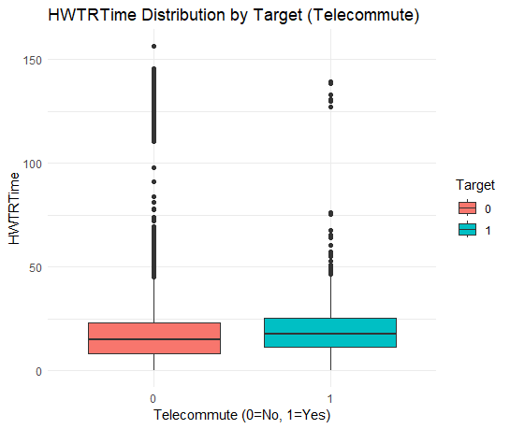
Other Variables Exploration

Slide 9
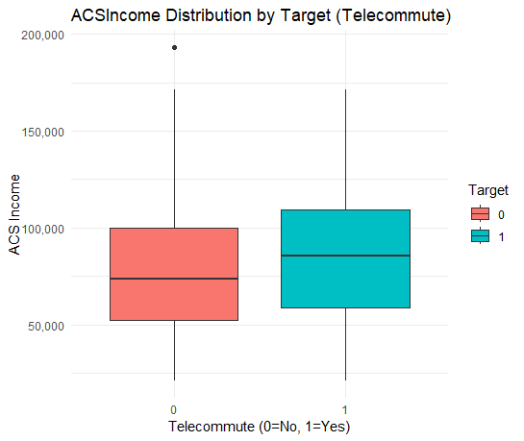
Other Variables Exploration
Average Values | Non-Telecommute (0) | Telecommute (1)
Household Vehicles | 2.11 | 2.17
Household Drivers | 1.92 | 1.94
Household Fulltime Workers | 1.58 | 1.59
Household Parttime Workers | 0.32 | 0.26
Pickup Or Dropoff Under 18 | 0.23 | 0.31
Pickup Or Dropoff 18 Plus | 0.08 | 0.05
Home to Work Travel Time | 17.09 | 19.13
Home to Work Distance | 12.27 | 13.33
ACS Income | 77172.68 | 85249.15

Slide 10
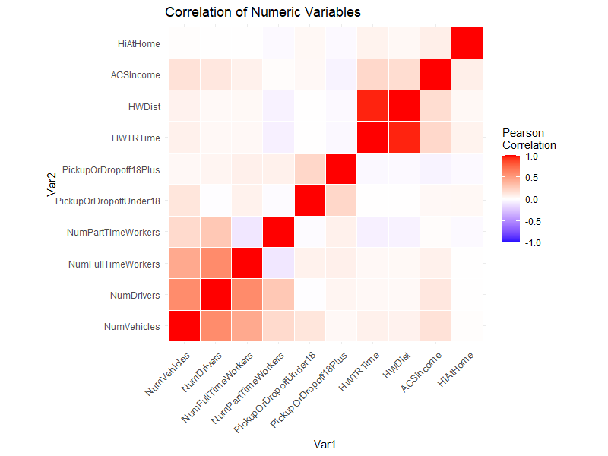
Correlation Matrix
Notes:
Strong correlation between workers, drivers, and vehicles. And strong correlations between income, commute time, commute distance, and work from home.

Slide 11
Data Mining: Classification
Purpose: Predict if a Worker Telecommutes (Telecommute Days > 0)
Data Preprocessing for Classification
  Split the Data into 70% Training Data and 30% Testing Data.
  Impute Missing Values.
  Create Classification Variable: Telecommute Days > 0.
Classification Models:
  Probit Regression
  Naïve Bayes
  Support Vector Machine
  Decision Tree
  Random Forest
  XGBoost

Slide 12
Classifications Confusion Matrices
Probit Model
Naïve Bayes
Prediction\Label | 0 | 1
0 | 9458 | 1073
1 | 1074 | 645
Prediction\Label | 0 | 1
0 | 9410 | 1121
1 | 1122 | 597
Support Vector Machine
Decision Tree
Prediction\Label | 0 | 1
0 | 9336 | 1195
1 | 1196 | 523
Prediction\Label | 0 | 1
0 | 10192 | 1394
1 | 340 | 324
Random Forest
XGBoost
Prediction\Label | 0 | 1
0 | 9552 | 1053
1 | 980 | 665
Prediction\Label | 0 | 1
0 | 9480 | 1055
1 | 1052 | 663

Slide 13
Classifications Model Compare
Model | Accuracy | Sensitivity(Recall) | Specificity | Precision | AUC
Decision Tree | 0.8584 | 0.1886 | 0.9677 | 0.488 | 0.705
Random Forest | 0.834 | 0.3871 | 0.907 | 0.4043 | 0.7737
XGBoost | 0.828 | 0.3859 | 0.9001 | 0.3866 | 0.788
Probit | 0.8247 | 0.3754 | 0.898 | 0.3752 | 0.7645
Naive Bayes | 0.8169 | 0.3475 | 0.8935 | 0.3473 | 0.732
SVM | 0.8048 | 0.3044 | 0.8864 | 0.3042 | 0.6854

Slide 14
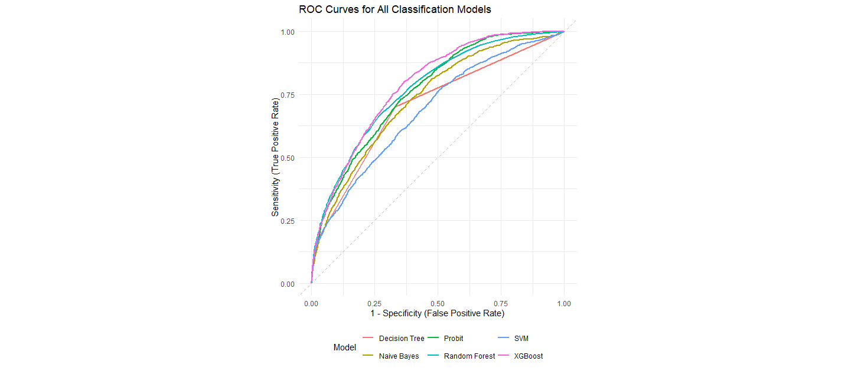
Classification: ROC Curves

Slide 15
SHAP Feature Importance
Variable | SHAP Score
NAICS2 | 0.053596
Home to Work Travel Time | 0.012369
ACS Income | 0.008043
Home to Work Distance | 0.006659
NO. of Fulltime Workers in HH | 0.005161
NO. of Vehicles in HH | 0.004155
NO. of Drivers in HH | 0.004018
Pickup or Dropoff Under18 | 0.001618
NO. of Parttime Workers in HH | 0.001448
Pickup or Dropoff 18 Plus | 0.001125
Variable | SHAP Score
NAICS2 | 0.05351
Home to Work Distance | 0.02766
Home to Work Travel Time | 0.02629
ACS Income | 0.0157
NO. of Drivers in HH | 0.01013
NO. of Vehicles in HH | 0.00976
NO. of Fulltime Workers in HH | 0.007
NO. of Parttime Workers in HH | 0.00621
Pickup or Dropoff Under18 | 0.00585
Pickup or Dropoff 18 Plus | 0.00133
XGBoost
Random Forest

Slide 16
Conclusions for Classifications
General Comparison
  Models had a hard time to forecast positives. (Low recalls)
  Decision tree model has the highest accuracy and specificity, but extremely low recall.
  Random forest and XGBoost improves recall without sacrificing other measures.
Random Forest and XGBoost Comparison
  Random Forest has highest recall and precision. (Best to catch positives)
  XGBoost has the highest AUC. (Best discriminative power)
Variables Importance
  NAICS2 (employer business sector), Home to Work Travel Time/Distance, Income have the strongest impact on classifications.

Slide 17
Data Mining: Clusters
Purpose: Cluster Employers based on Commute Time and Telecommute Days
  Find Employer Features that may or may not be Represented by NAICS Code.
Data Preprocessing for Clusters:
  Average Telecommute Days and Home to Work Travel Time for All Employers.
  Normalize the Average Commute Time and Average Telecommute Days.
Clustering Models:
  K-means
  Partitioning Around Medoids (PAM)
  Density-Based Spatial Clustering of Applications with Noise (DBSCAN)

Slide 18
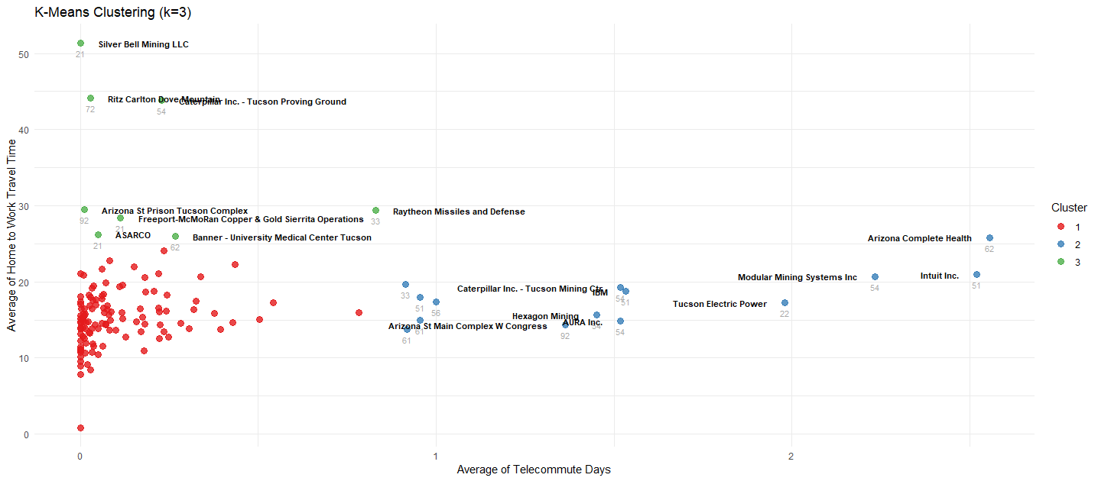
K-means 3 Clusters

Slide 19
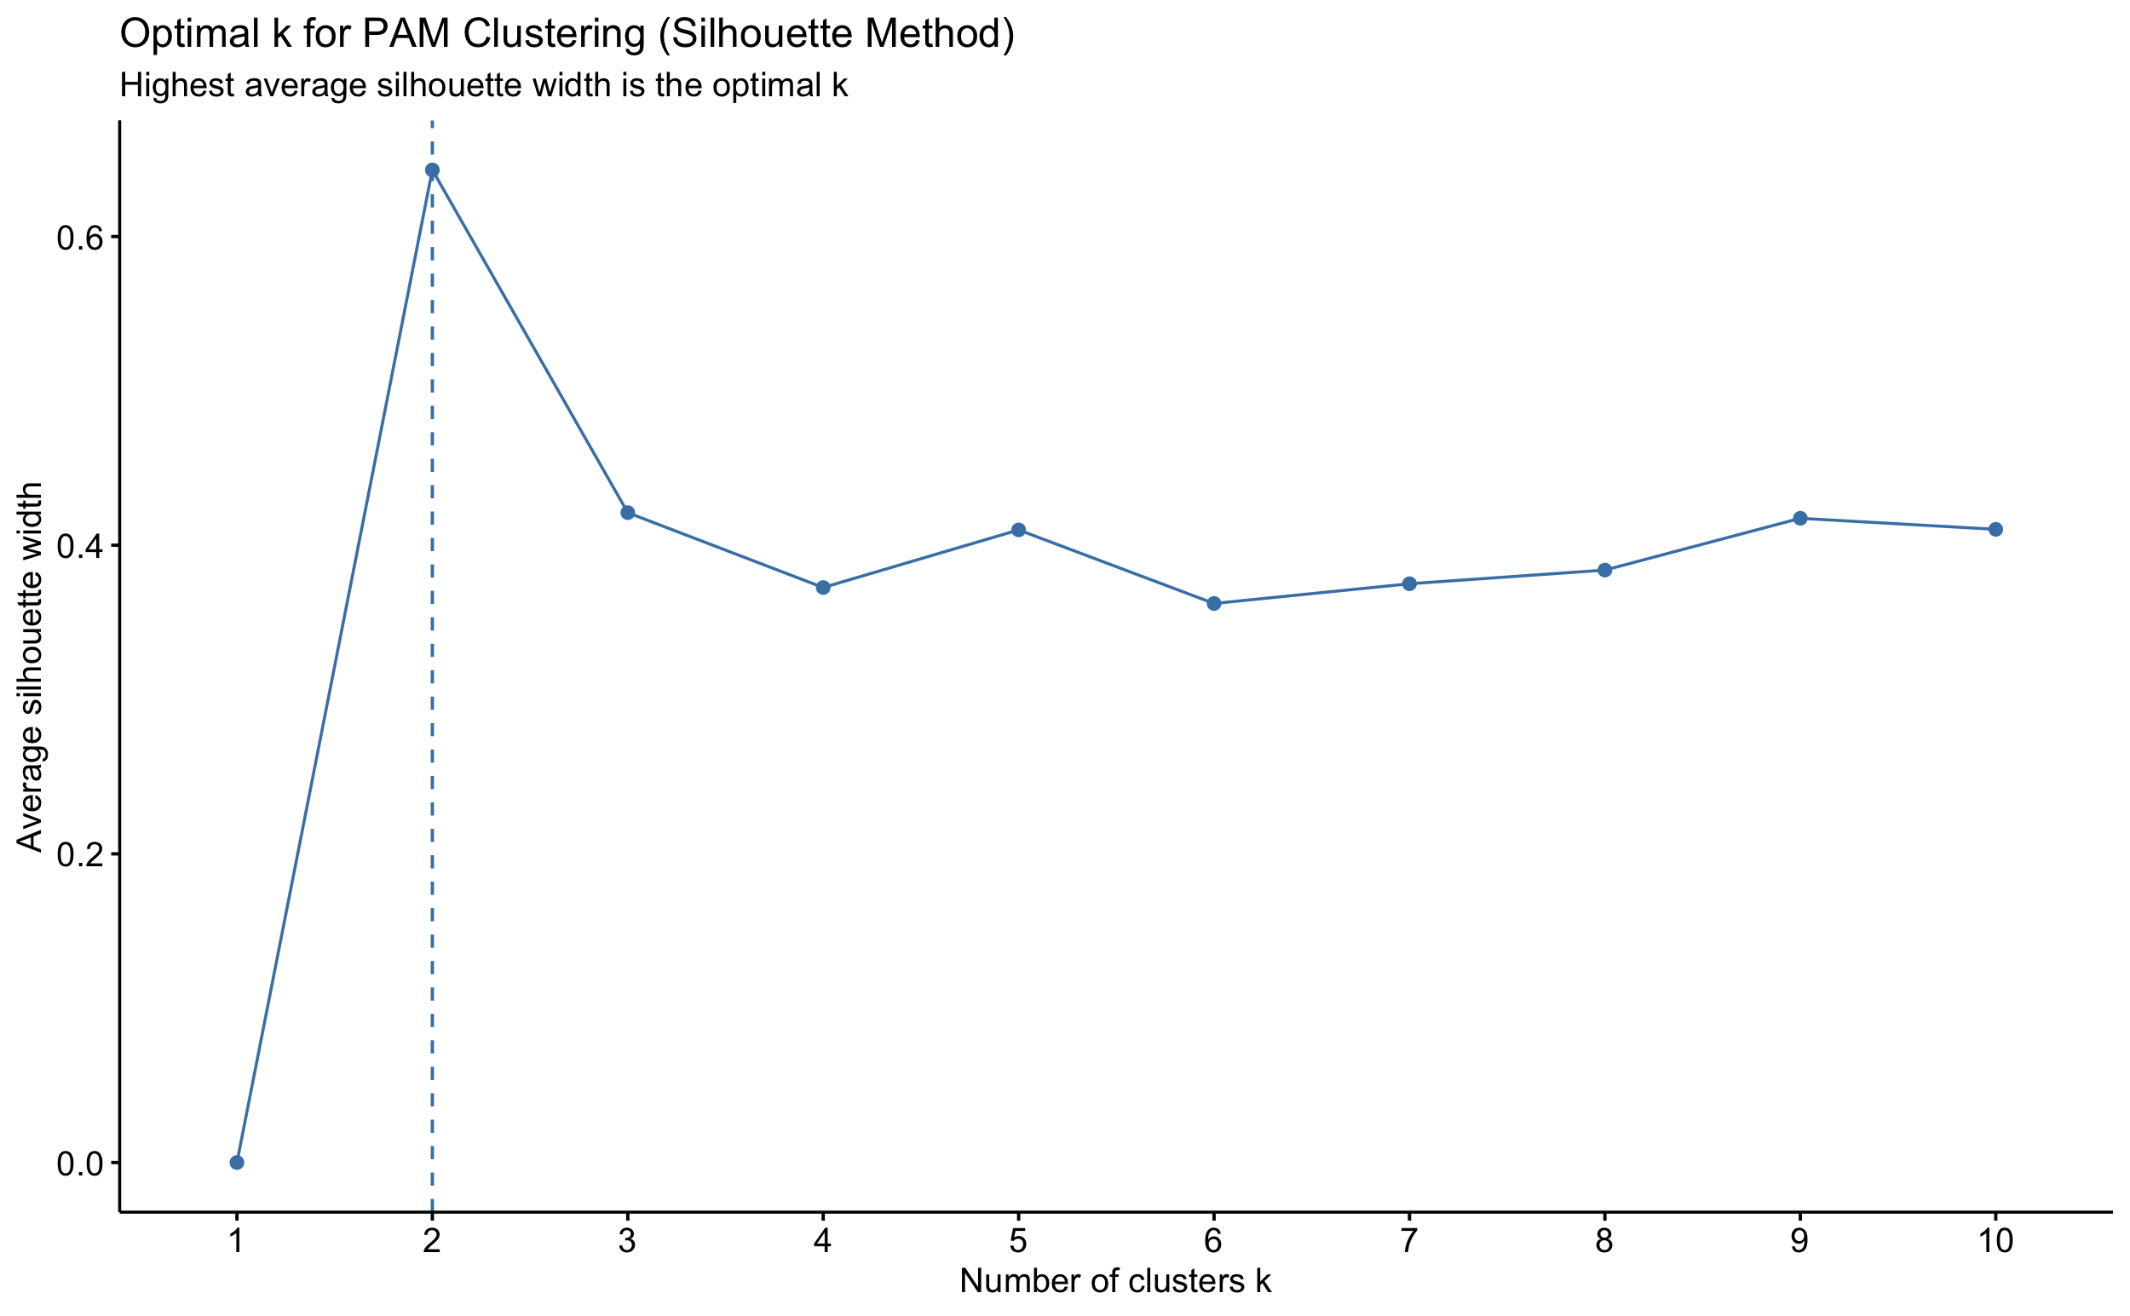
PAM: Finding Number of Clusters

Slide 20
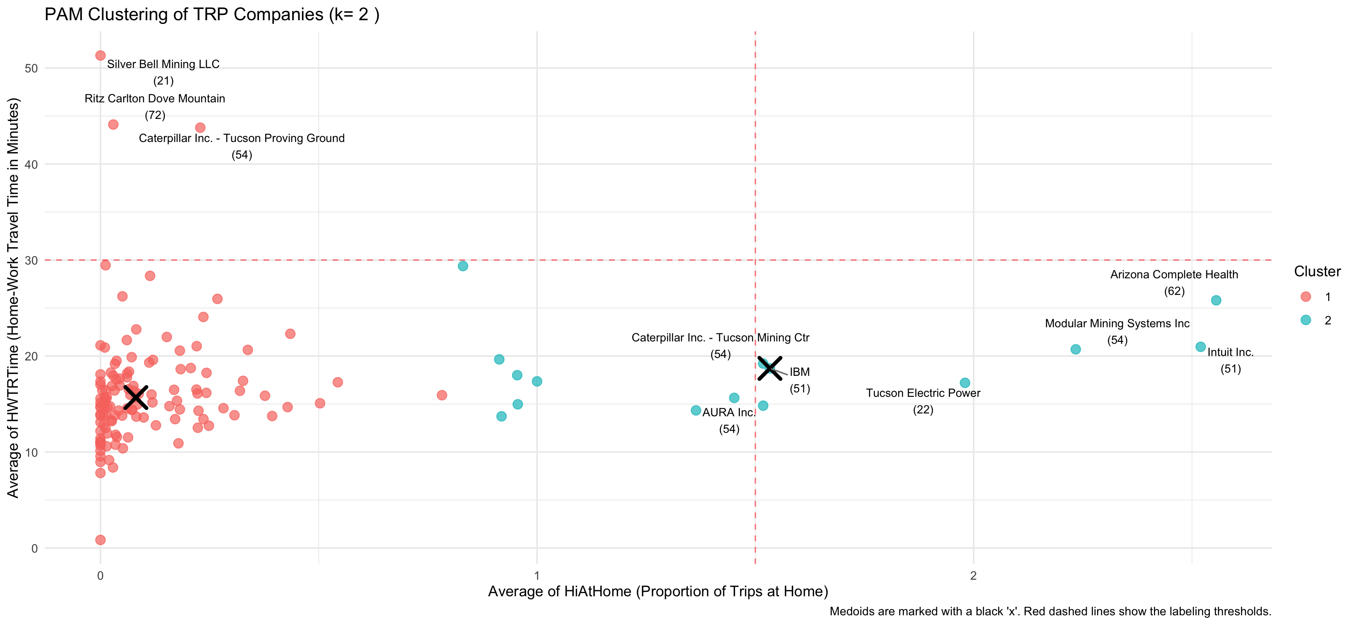
PAM
Notes:
objective: Identify enterprise groups with similar commuting characteristics.Provide data support for transportation planning/policy-making.
Data preprocessing:
- Original data: 138 companies, over 20 commuting indicators
- Cleaning steps:
- Remove non-numeric columns (' Company ', 'NAICS2')
Automatically eliminate zero-variance variables
- ** Detect and remove outliers ** (Markov distance + business rules)
Final sample: **135 companies ** (3 exceptions removed)
Clustering Method Selection: PAM (Partitioning Around Medoids)
- Advantages:
- Robust to outliers (pre-processed)
- Does not rely on the spherical cluster assumption
- Provide a clear "medoid"
Automatically select the optimal K using the ** contour coefficient **

Slide 21
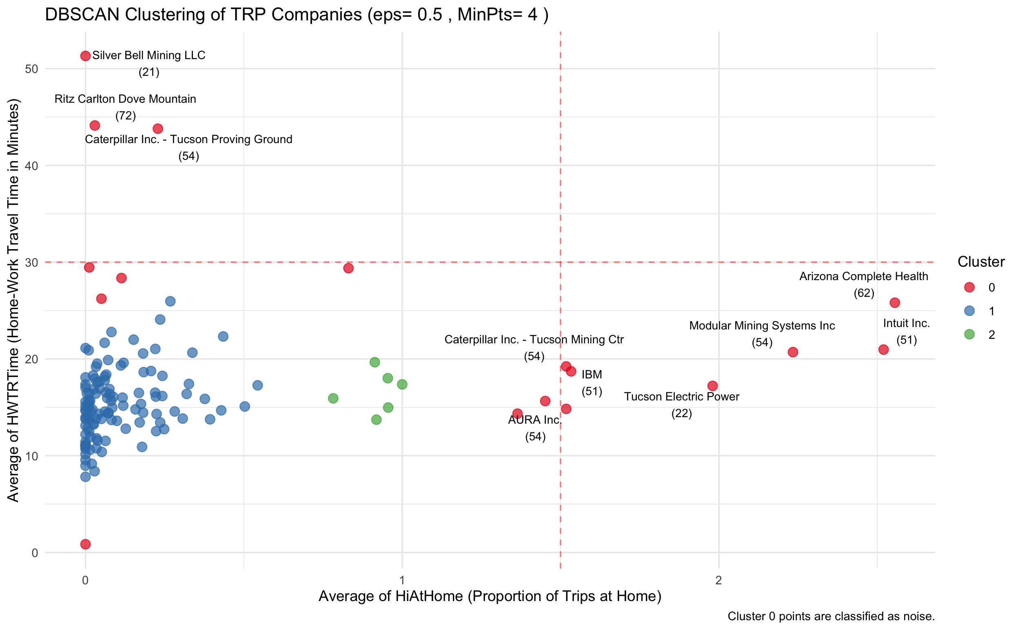
Density Clustering DBSCAN
Notes:
Results of density clustering analysis
- Try DBSCAN
- Try OPTICS
- Includes outlier handling and standardization
Result
137 points (Cluster 0)， 1points (Cluster 1)
The PCA projection shows that the data present a continuous band-like distribution without any separated clusters
Conclusion
There is no significant density cluster structure in the enterprise commuting mode

Slide 22
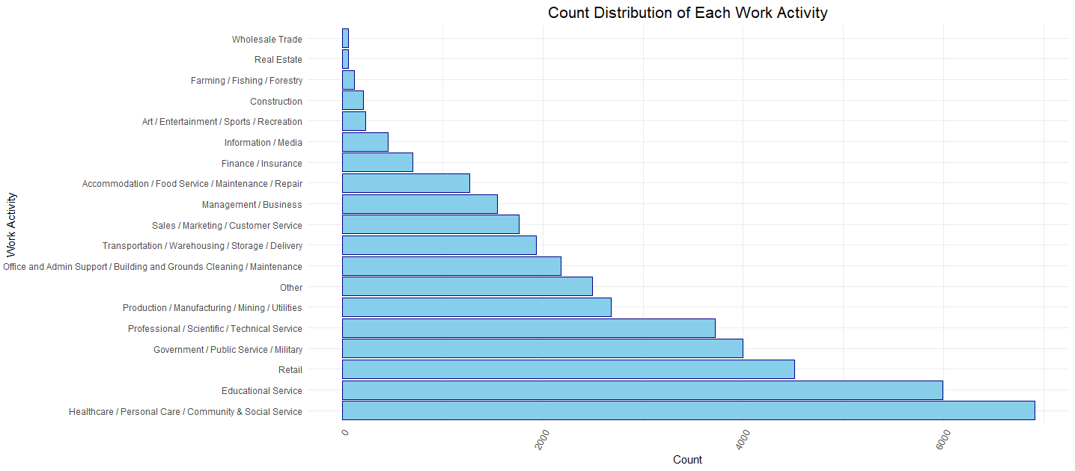
Association Rules: Apriori
Purpose: Exploring the Work Activities of Each Company based on Apriori.
  Does a set of work activities associate with another set of work activities.

Slide 23
Rules Mined
lhs |  | rhs | support | confidence | coverage | lift | count
{Office and Admin Support / Building and Grounds Cleaning / Maintenance, Sales / Marketing / Customer Service} | => | {Management / Business} | 0.63 | 0.92 | 0.69 | 1.09 | 87
{Finance / Insurance} | => | {Office and Admin Support / Building and Grounds Cleaning / Maintenance} | 0.61 | 0.98 | 0.62 | 1.09 | 84
{Accommodation / Food Service / Maintenance / Repair,Management / Business} | => | {Office and Admin Support / Building and Grounds Cleaning / Maintenance} | 0.60 | 0.98 | 0.62 | 1.09 | 83
{Accommodation / Food Service / Maintenance / Repair, Office and Admin Support / Building and Grounds Cleaning / Maintenance} | => | {Management / Business} | 0.60 | 0.91 | 0.66 | 1.09 | 83
{Sales / Marketing / Customer Service} | => | {Management / Business} | 0.66 | 0.91 | 0.72 | 1.08 | 91
{Professional / Scientific / Technical Service} | => | {Office and Admin Support / Building and Grounds Cleaning / Maintenance} | 0.67 | 0.97 | 0.69 | 1.08 | 92

Slide 24
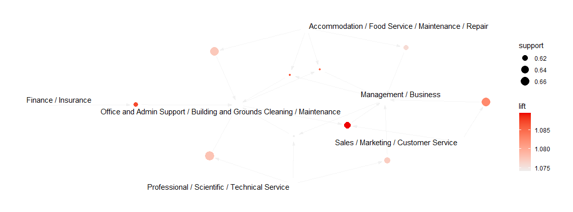
Network Graph of Mined Rules

Slide 25
Association: Rule-based Classification
Based on FP-Growth.
Data Discretization for ACS Income and Home to Work Travel Time.
Classify Telecommute Workers from ACS Income, Home to Work Travel Time, and NAICS Code.

Slide 26
Rules Before Pruning
lhs |  | rhs | support | confidence | lift
{NAICS2=48} | => | {WorkFromHome=False} | 0.01 | 0.96 | 1.13
{NAICS2=21} | => | {WorkFromHome=False} | 0.02 | 0.94 | 1.10
{NAICS2=56} | => | {WorkFromHome=False} | 0.02 | 0.96 | 1.12
{NAICS2=72} | => | {WorkFromHome=False} | 0.02 | 0.96 | 1.12
{NAICS2=49} | => | {WorkFromHome=False} | 0.03 | 0.99 | 1.16
{NAICS2=54} | => | {WorkFromHome=True} | 0.01 | 0.41 | 2.89

Slide 27
Rules After Pruning
lhs |  | rhs | support | confidence | lift
{NAICS2=49} | => | {WorkFromHome=False} | 0.03 | 0.99 | 1.16
{} | => | {WorkFromHome=True} | 0.86 | 0.86 | 1

Slide 28
Conclusions for Associations
Apriori Associate Rules:
  Every frequent sets of work activities are associated with admin activities or management activities.
FP Growth Rule-based Classification:
  Sample data is unbalanced. Negative samples dominate the training data.
  Decision tree classification works better by maximizing the entropy.

Slide 29
Questions?
Thank you very much!

